Slide 1
Session – 22
Test Driven Development

Slide 2
Test Driven Development (TDD) Vs. Agile Model Driven Development (AMDD)
TDD | AMDD
TDD shortens the programming feedback loop | AMDD shortens modeling feedback loop.
TDD is detailed specification | AMDD works for bigger issues
TDD promotes the development of high-quality code | AMDD promotes high-quality communication with stakeholders and developers.
TDD speaks to programmers | AMDD talks to business analyst, stakeholders, and data professionals.
TDD non-visually oriented | AMDD visually oriented
TDD has limited scope to software works | AMDD has a broad scope including stakeholders. It involves working towards a common understanding
Both support evolutionary development | --------------------------------------------

Slide 3
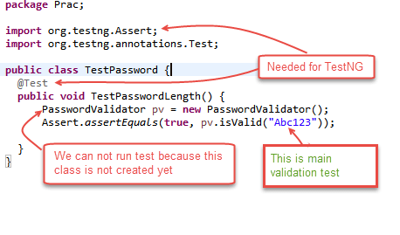
Examples of TDD: Here in this example, we will define a class password. For this class, we will try to satisfy following conditions. A condition for Password acceptance: The password should be between 5 to 10 characters. First, we write the code that fulfills all the above requirements.

Slide 4
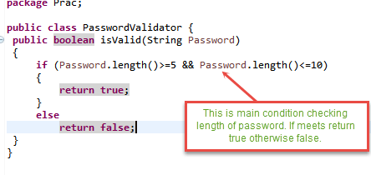
Scenario 1: To run the test, we create class PasswordValidator (); We will run above class TestPassword ();

Slide 5
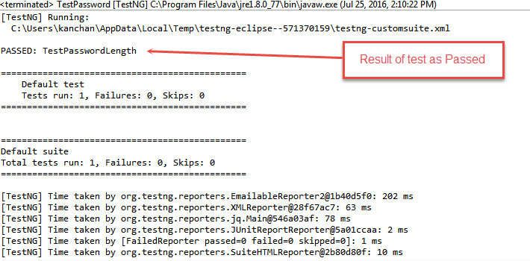
Output is PASSED as shown below

Slide 6
Advantages of TDD
Early bug notification
Better Designed, cleaner and more extensible code
Confidence to Refactor
Good for teamwork
Good for Developers

Slide 7
Summary
Test-driven development is a process of modifying the code in order to pass a test designed previously.
It more emphasis on production code rather than test case design.
In Software Engineering, It is sometimes known as "Test First Development."
TDD includes refactoring a code i.e. changing/adding some amount of code to the existing code without affecting the behavior of the code.
TDD when used, the code becomes clearer and simple to understand.

Slide 8
Questions
Distinguish Test Driven Development (TDD) Vs. Agile Model Driven Development (AMDD)
Explain any two scenarios of TDD with an Example
Distinguish TDD Vs. Traditional Testing
List out the advantages of TDD

